Slide 1
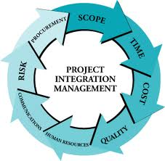
Project Integration Management

Slide 2
What is Project Integration Management?
A process of unification, consolidation and integrative action that are crucial to project completion with in PM process groups.
It is a process and activities needed to identify, define, unify, combine and coordinate all project activities in PM process groups.
It is putting everything together in the way that how to achieve project objectives.

Slide 3
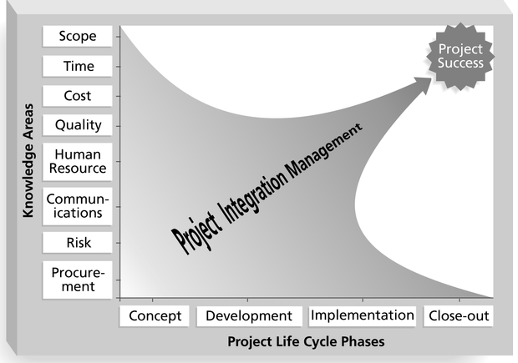
Framework for Project Integration Management
Focus on pulling everything together to reach project success!

Slide 4
Contt..
It ensures stability in all areas of a project such as scope, time, costs, HR, quality, communication, RM, and others.
These interconnected processes cannot be carried out by a single team.
This is a highly valued aspect of the PMI.
It mainly focuses on ensuring proper coordination between project activities.
Effective integration management means a critical success factor for project manager and the Key to overall project success.

Slide 5
Good Project Integration Management
Project managers must coordinate all of the other knowledge areas throughout a project’s life cycle.
Project integration management is not the same thing as software integration.

Slide 6
Project Integration Management Processes
Project integration management involves seven key processes/ activities:-
Develop project charter
Maintaining project knowledge
Project Plan Development
Project Plan Execution
Leading project work
Perform integrated change control
Close project or phase

Slide 7
Building a Project Charter
A project charter is an official doc that reflects a complete description of project deliverables and establishes project goals.
It is a short formal document that states purpose and key elements of a project.
It is a brief 2/3 page document or an excellent executive summary of the project that tells high-level information about the project.
The process of developing a document that formally authorizes the existence of a project and provides the project manager with the authority to apply organizational resources to project activities.
This draft includes: objectives, scope, budget of the project, and soon.

Slide 8
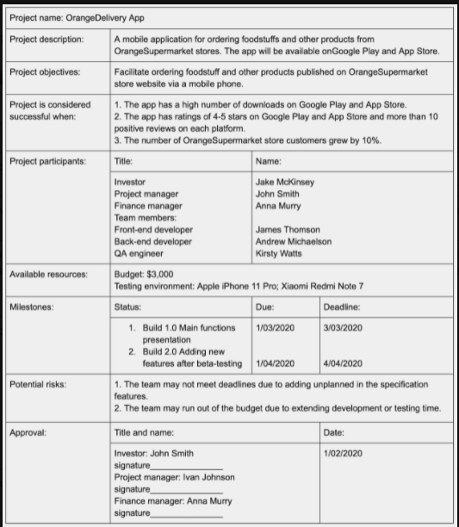
Sample of Project Charter

Slide 9
Maintaining Project Knowledge
In order to accomplish the goals, projects require specific knowledge.
Different projects usually require a special team member with strong skills to carry out the work that not everyone enjoys.
This can be existing/new knowledge, obtained through experience, explicit or tacit.
The knowledge needed to perform the project’s work in a good manner must be planned via PIM.

Slide 10
Project Plan Development
A project plan is a document used to coordinate all project planning documents
Or taking the results of other planning processes and putting them into a consistent, coherent document.
The process of defining, preparing, and coordinating all of the subsidiary plans and integrating them into a comprehensive whole.
Its main purpose is to guide project execution.
It support project manager for leading project team and assessing project status.
Project performance should be measured against a baseline project plan.

Slide 11
Attributes of Project Plans
Just as projects are unique, so are project plans
Plans should be dynamic (If anything changes, the project plan must be updated and re-approved)
Plans should be flexible
Plans should be updated as changes occur
Plans should first and foremost guide project execution.

Slide 12
Common Elements of a Project Plan
Introduction or overview of the project
Description of how the project is organized
Management and technical processes used on the project
Work to be done, schedule, and budget information

Slide 13
Sample Outline for a Software Project Management Plan (SPMP)

Slide 14
Stakeholder Analysis
A stakeholder analysis document include important information about stakeholders such as
  stakeholders’ names and organizations
  roles on the project
  unique facts about stakeholders
  level of influence and interest in the project
  suggestions for managing relationships

Slide 15
Sample Stakeholder Analysis

Slide 16
Project Plan Execution
Project plan execution involves managing and performing the work described in the project plan.
It means, carrying out the project plan(5-20 pages).
The application area or project directly affects project execution because the products of the project are produced during execution

Slide 17
Cott..
Project execution is about applying real actions.
The majority of time and money is usually spent on execution.
A project manager must implement project activities and monitor their execution.
Managing a project team is also a part of this process.

Slide 18
Important Skills for Project Execution
General management skills like leadership, communication, and political skills
Product skills and knowledge
Use of specialized tools and techniques

Slide 19
Tools and Techniques for Project Execution
Work Authorization System: a method for ensuring that qualified people do work at the right time and in the proper sequence.
Status Review Meetings: regularly scheduled meetings used to exchange project information
Project Management Software: special software to assist in managing projects

Slide 20
Leading Project Work
The process of leading and performing the work defined in the project management plan and implementing approved changes to achieve the project's objectives.
Manage the project in terms of time , cost, scope….
It involves measuring and balancing the project progress.
Project managers should be proactive in making corrections and crucial measures to eliminate the challenges and issues that can hover the overall success.

Slide 21
Integrated Change Control
Integrated change control involves identifying, evaluating, and managing changes throughout the project life cycle.
Or coordinating changes across the entire project.
The process of reviewing all change requests, approving changes and managing changes to PM plain , deliverables, and other project document.
It is somewhat difficult task, as PMs may face backlash from their teammates /colleagues.

Slide 22
Contt..
When performing change controls, you can easily approve, calculate, and direct changes in the way you need.
As a result, you get advanced customer satisfaction and the ability to drive your project to success.
Three main objectives of change control:
  Determine that a change has occurred
  Influence the factors that create changes to ensure they are beneficial
  Manage actual changes when and as they occur.

Slide 23
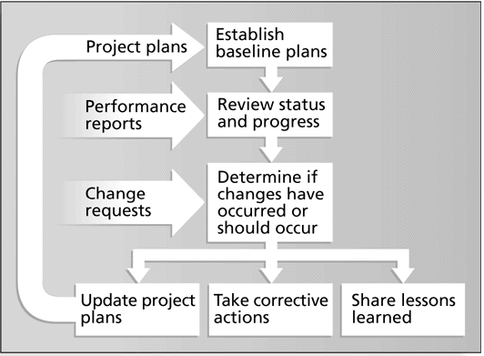
Integrated Change Control Process

Slide 24
Change Control on Software Projects
Former view: The project team should strive to do exactly what was planned on time and within budget
Problem: Stakeholders rarely agreed up-front on the project scope, and time and cost estimates were inaccurate
Modern view: Project management is a process of constant communication and negotiation
Solution: Changes are often beneficial, and the project team should plan for them

Slide 25
Change Control System
A formal, documented process that describes when and how official project documents and work may be changed.
Describes who is authorized to make changes and how to make them.
Often includes a Change Control Board (CCB), configuration management, and a process for communicating changes

Slide 26
Change Control Boards (CCBs)
A formal group of people responsible for approving or rejecting changes on a project
Provides guidelines for preparing change requests, evaluates them, and manages the implementation of approved changes.
Includes stakeholders from the entire organization

Slide 27
Making Timely Changes
Some CCBs only meet rarely, so it may take too long for changes to occur
Some organizations have policies in place for time-sensitive changes
  “48 hour policy” allowed project team members to make decisions, then they had 48 hours reverse the decision pending senior management approval
  Delegate changes to the lowest level possible, but keep everyone informed of changes

Slide 28
Configuration Management
Experts identify and document configuration requirements, control changes, record and report changes, and audit the products to verify conformance to requirements.

Slide 29
Suggestions for Managing Integrated Change Control
View project management as a process of constant communications and negotiations.
Plan for change
Establish a formal change control system, like CCB.
Use good configuration management
Define procedures for making timely decisions on smaller changes( use polices).
Use written and oral performance reports to identify and manage changes.
Use project management and other software in order to manage and communicate changes.

Slide 30
Closing Project
The process of finalizing all activities across all of the project management process groups.
When you have completed all project tasks and activities, delivered the outcome to customers, and received their approval, it is time to close the project.
Administrative closure : final acceptances .
Contract closure /shutting

